Slide 1
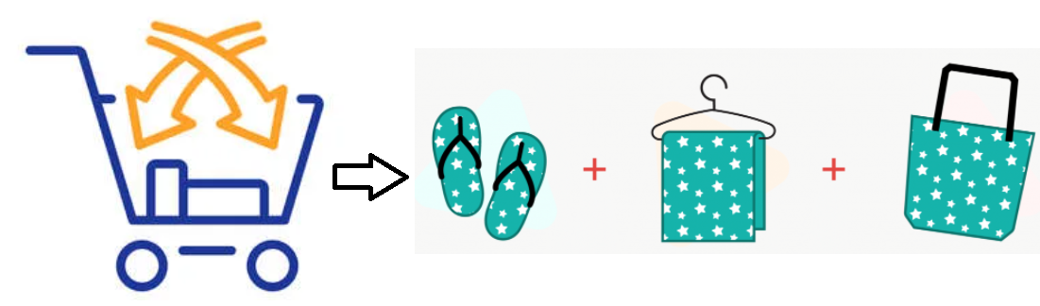
Cross-Sell Insurance

Slide 2
AGENDA
Solution Process
Key Findings
Potential
Benefits
Problem Overview
MODELS COMPARISION
Recommendation

Slide 3

Problem Overview
What is the problem?
A consumer bank with a range of products would like to cross-sell the personal protection insurance (PPI) product to those customers who have a secured or unsecured type of loan, but no PPI product yet.
The bank would like to adopt analytics driven approach applied on this sample data for deciding:
Who should they target from the pool of customers that currently do not have a PPI, and
What type of PPI product they should be targeting them with.

Slide 4




Solution Process
Dataset provided has 16383 observations and 59 features.
Dataset had Behaviour data, Demographic data, Cross-Product holdings Explanation etc
Model Validation
STEP
04
Model Performance measure on
testing data
Model Preparation
STEP
03
Selecting the best model and train
the model on Training dataset.
Data Preparation and EDA
STEP
02
Anomaly Treatment, Missing Values Treatment, creating new variables, Selecting important features and scaling.
Data Collection & Understanding
STEP
01
Collecting the Data from appropriate sources and understanding the data .

Slide 5
MODELS COMPARISION
MODEL 1
Logistic
Regression
MODEL 2
Decision
Tree
MODEL 3
Random
Forest
Training | Testing
81%
Started with simple logistic regression.
Training | Testing
80%
Used Decision tree Classifier.
Training | Testing
87% | 71%
Used Random Forest Ensemble model
Accuracy

Slide 6
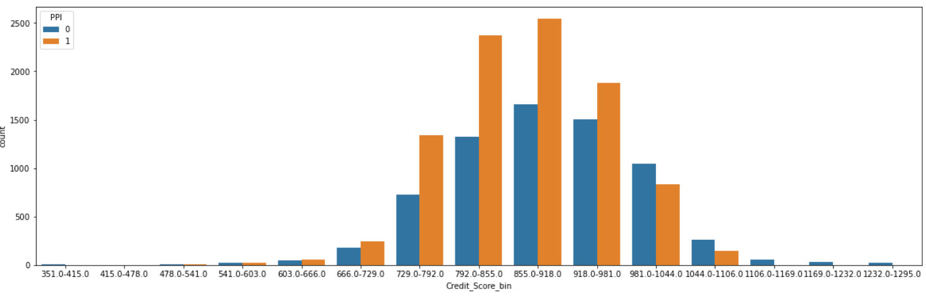

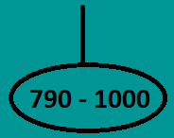
Key Insights
The most important factors that influence the problem
Feature 1
Credit Score
Credit Score v/s PPI
PPI products are more likely to be bought by customers with a credit score between 790 and 1000

Slide 7
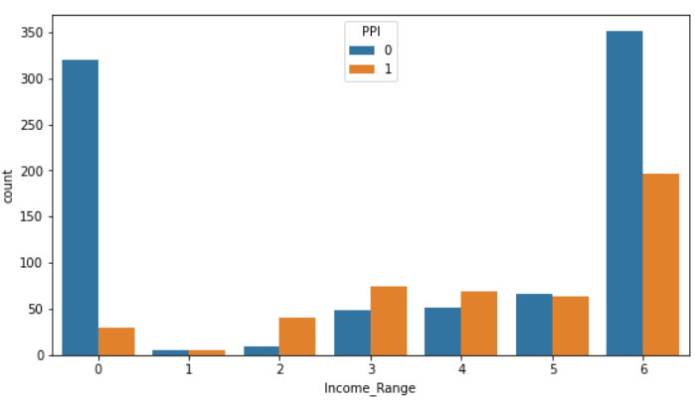

Key Insights
Income range v/s PPI
Feature 2
Income Range
3 - 6
Income range = 6 accounted for 38% of all income ranges
Customers between 3 & 6 (inclusive) income range are likely to prefer PPI products

Slide 8
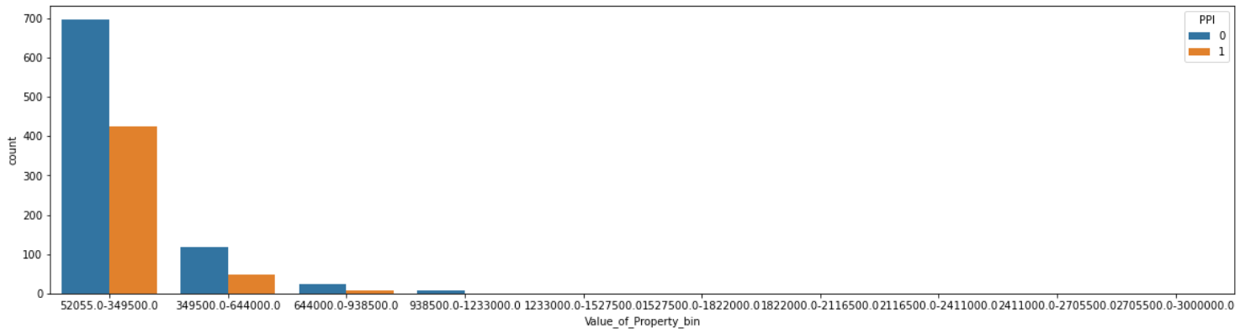

Key Insights
Property value v/s PPI
Feature 3
Property Value
PPI products can be targeted to customers with a value of property b/w 0 and 349500, accounts for 25%-30% of the total customers
0-349500

Slide 9
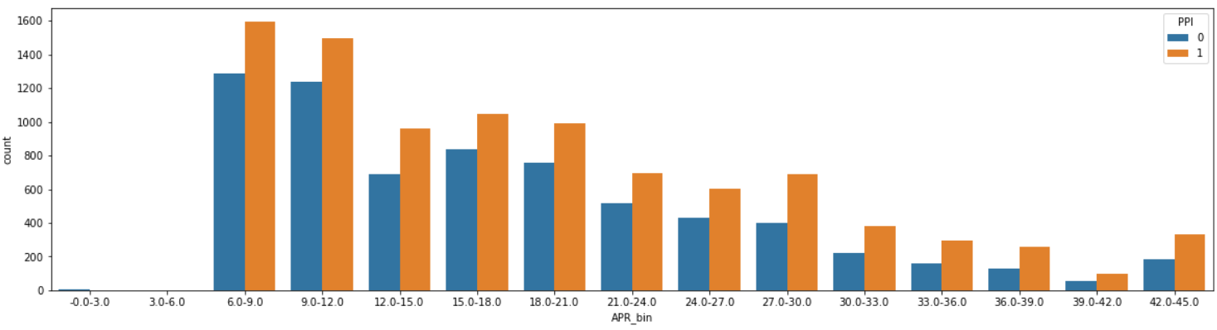

Key Insights
Feature 4
APR
APR v/s PPI
Customers with loans of APR 6 to 30 are likely to prefer PPI products
6 - 30

Slide 10
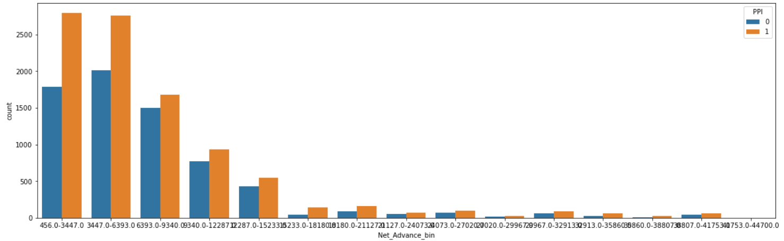

Key Insights
Feature 5
Net Advance
Net Advance v/s PPI
Customers with Net advance between 3447 to 12287 are like to buy PPI products.
0-12287

Slide 11
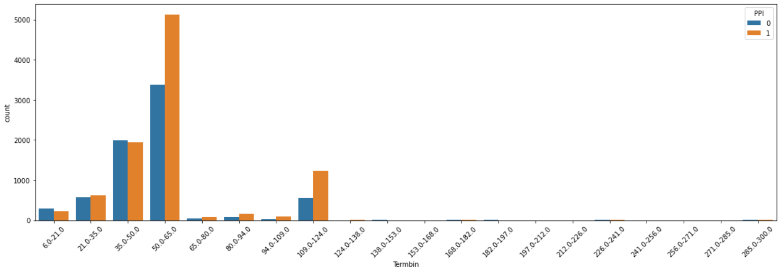

Key Insights
Feature 6
Term
Term v/s PPI
2 – 5 yrs
- About 50% of the terms were of 50-65 months irrespective of the PPI flag
- People with term plan between 2 to 5 years and 10 years can buy insurance. It is highly like for people with 5 term plan to buy insurance

Slide 12
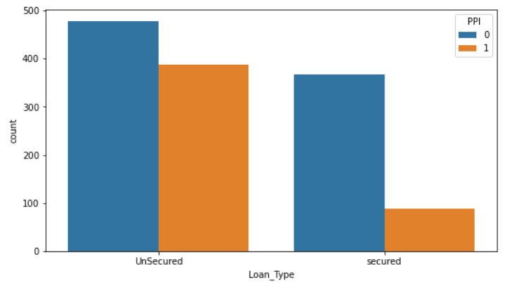
Key Insights
Loan Type v/s PPI
Feature 7
Loan Type
Data shows that there are higher number of unsecured loan preferring customers
Unsecured

Slide 13
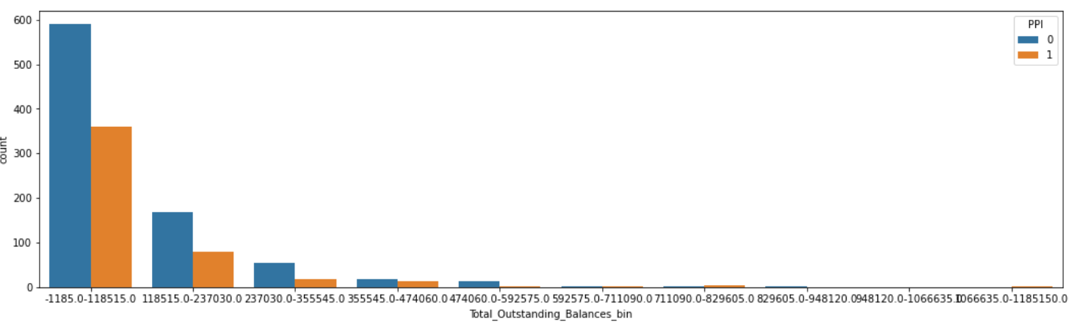

Key Insights
Feature 8
Outstanding Balance
Outstanding Balance v/s PPI
People with low outstanding balance(0-118515) are highly likely to buy insurance.
0-118515

Slide 14
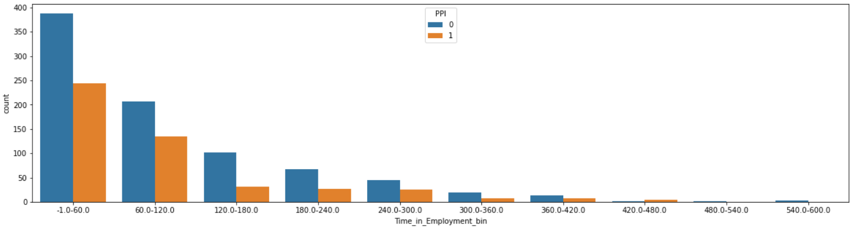

Key Insights
Time in Employment v/s PPI
Feature 9
Time in Employment
Customers who are employed between 60 to 120 are likely to buy PPI Products
60-120

Slide 15
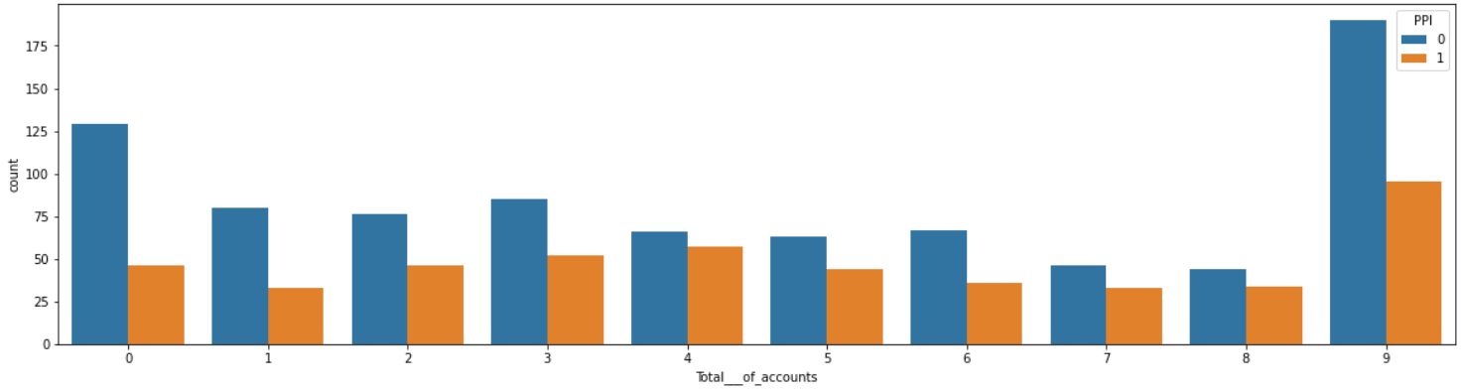

Key Insights
Feature 10
No of Accounts
No of Accounts v/s PPI
Customers with 9 number of accounts accounted for a whopping 30% of all customers
Customers with total number of accounts ranging from 0 to 9 (inclusive) are likely to prefer PPI products.
9 accounts

Slide 16
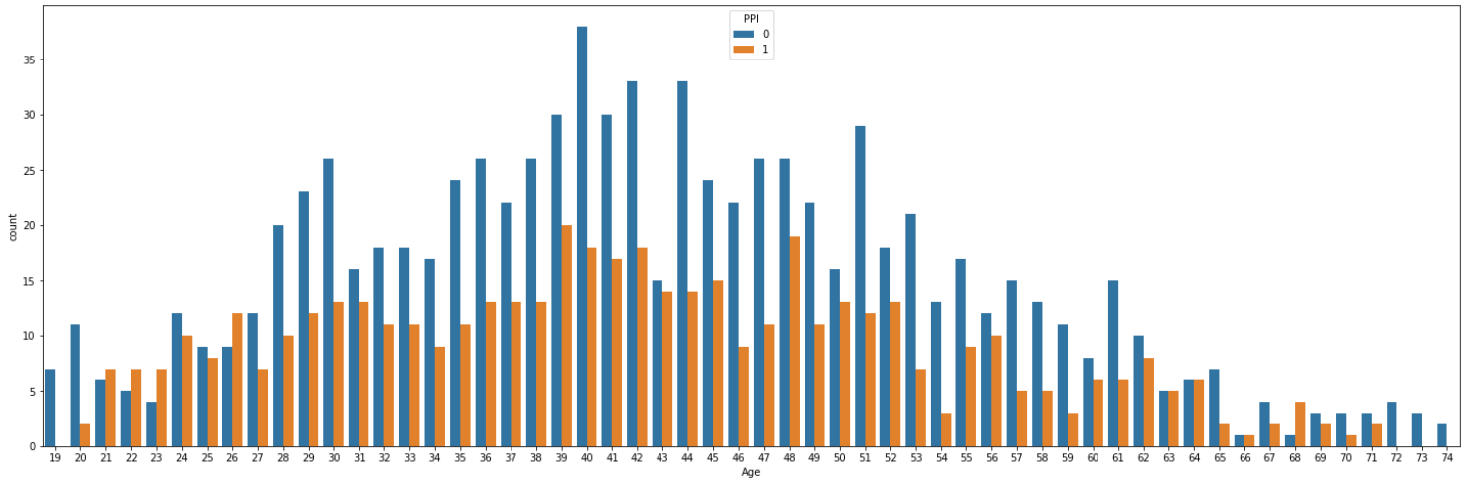

Key Insights
Age v/s PPI
Feature 11
Age
Age group 30 to 55 hold ~37% of PPI products and they can be targeted for PPI products.
Age group 40-50 can be targeted for joint PPI products
30-55

Slide 17
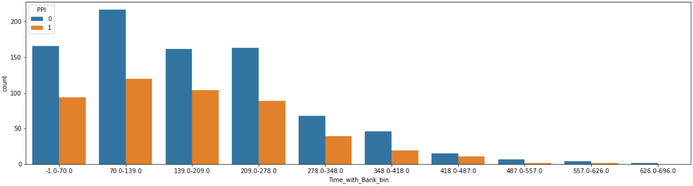

Key Insights
Feature 12
Time with Bank
Time with Bank v/s PPI
Customers who are with bank between 70 to 278 days are likely to buy PPI Products
70-278

Slide 18
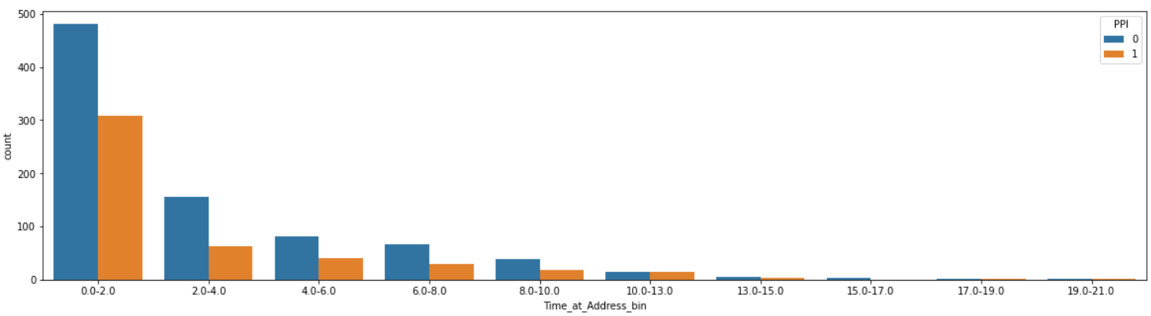
Key Insights
Time at address v/s PPI
Feature 13
Time at address
Customers staying at the address between 0 and 260 days (0-8 months) can be prioritized for cross-selling PPI products
0 - 8

Slide 19
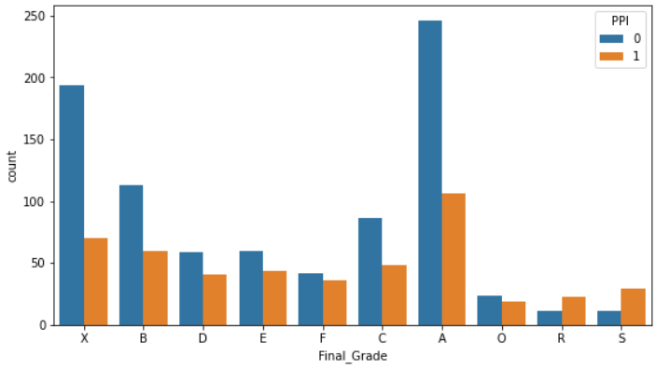

Key Insights
Feature 14
Final grade
A - X
Customers with grades from A to X can be approached for insurance and they
are likely to buy PPIs than others.

Slide 20
Recommendation
Recommendation 1
Bank should target customers with credit score between 792 and 981 to sell PPI products.
Customers with credit score between 855 and 918 can be approached for Joint PPI and PPI LCI
Recommendation 2
Customers with income range from medium to high (3-6)can be approached for PPI and it is highly likely that people with high income(6) can buy insurance.
- People prefer PPI_single over others.
Recommendation 3
PPI products can be targeted to customers with a value of property between 0 and 349500, with Net advance between 3447 to 12287 and with loans of Annual Percentage Rate between 6 to 30.
Recommendation 4
Customers with Unsecured Loan type with term plan between 2 to 5 years and 10 years with low outstanding with 9 accounts and aged between 30-55 can buy insurance who are Full time permanent employees for 60-120 days and who are with bank for 70-278 can be approached for insurance.

Slide 21

Benefits 1
Benefits 2
Benefits 3
Potential Benefits of Cross-Selling
1. Helps Customers Feel Understood
The best cross-selling helps customers feel understood. If you are right on target, customers will form a greater connection with you and your brand, feeling like you really understand their personality and connect on a higher level.
2. Builds Loyalty
Customers who feel a stronger connection with your brand are more likely to stick around for the long haul. In fact, these customers might even turn into brand ambassadors who spread the word about your business to friends and family. When you offer not just one, but several products the customer loves, they will become devoted to your brand, saving you money by reducing churn rates.
3. Increases Earnings
A customer who buys multiple products or services will help to boost your earnings more than a customer who buys just one product. If cross-selling increases customer satisfaction, you will save money by spending less time and resources on customer acquisition.

Slide 22
Potential Benefits of Cross-Selling
4. Greater Convenience
Today’s consumers prize convenience. No one wants to go driving from store to store to find every product they are looking for. And even jumping from one website to another can be a headache. So, when you cross-sell them a product they really love, your customers will be glad to come back time and time again. Strive to become a one-stop shop, and you will have an easier time beating out the competition.
5. Moves Customers Through the Buying Journey
As any experienced salesperson knows, customers sometimes tend to draw out purchasing decisions over long periods of time. They might debate about whether they need an item, spend time shopping around for the best price, or wait for a great sale. But cross-selling can give customers the added boost they need to move through the buying journey, increasing their motivation to pick up everything they need in one place.

Slide 23

Thanks..

